Slide 1
Nanotechnology. Allotropes of Carbon
II ELS „Thomas Jefferson“

Slide 2
Nanotechnology
In 1959 the Nobel Prize winning physicist Richard Feynman gave a groundbreaking talk about the physical possibility of making, manipulating and visualizing things on a small scale and arranging atoms “the way we want”. Feynman challenged scientists to develop a new field where devices and machines could be built from tens or hundreds of atoms. This field is now called nanotechnology, which has been described as “the science of the very small with big potential”.

Slide 3
Definition of Nanotechnology
Nanotechnology is defined as the research and technology development in the 1 – 100 nm range. Nanotechnology creates and uses structures that have novel properties because of their small size. It builds on the ability to control or manipulate matter on the atomic scale.

Slide 4
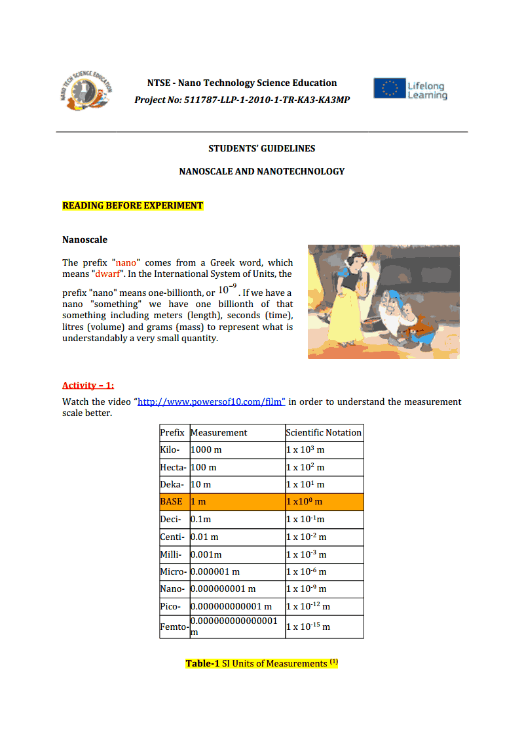

Slide 5
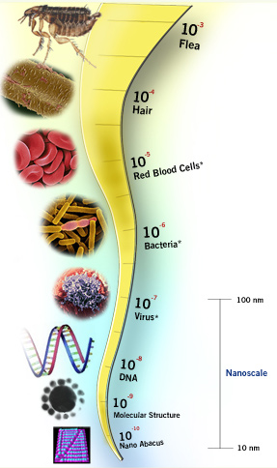
Some examples of nanoscale are:
A sheet of paper is about 100 000 nanometres thick.
A human hair measures roughly 50 000 to 100 000 nanometres across.
Your fingernails grow one nanometre every second.
A single blink of an eye is about one-billionth of a year (a nano year).
A single water molecule is about 1/4th of a nanometre across.
10 hydrogen atoms lined up next to one another spans 1 nanometre.
A cell membrane is about 9 nanometres thick.
A virus is approximately 70 nanometres wide.
A strand of human DNA is 2,5 nanometres in diameter.
A single gold atom is about a third of a nanometer in a diameter.

Slide 6
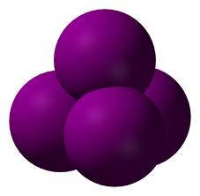
Carbon
Carbon (from Latin: carbo "coal") is the chemical element with symbol C and atomic number 6. As a member of IV “A” group on the periodic table, it is nonmetallic and tetravalent—making four electrons available to form covalent chemical bonds.

Slide 7
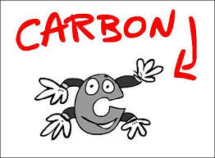
All carbon allotropes are solids under normal conditions with graphite being the most thermodynamically stable form. They are chemically resistant and require high temperature to react even with oxygen.

Slide 8
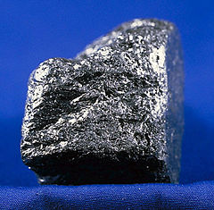
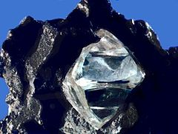
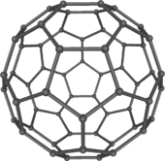
The three allotropes of carbon
Graphite
Diamond
Fullerene

Slide 9
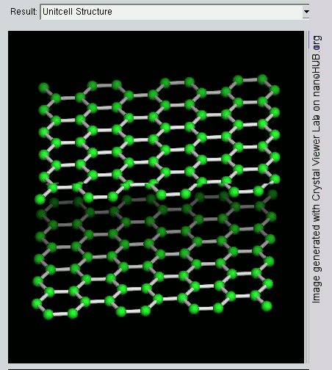
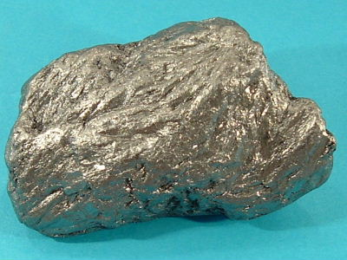
Graphite
The mineral graphite is an allotrope of carbon. It was named by Abraham Gottlob Werner in 1789. Unlike diamond (another carbon allotrope), graphite is an electrical conductor, a semimetal. It is useful in such applications as arc lamp electrodes.

Slide 10
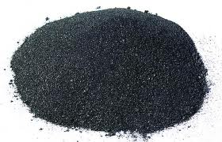
Graphite is the most stable form of carbon under standard conditions. Therefore, it is used in thermochemistry as the standard state for defining the heat of formation of carbon compounds.

Slide 11
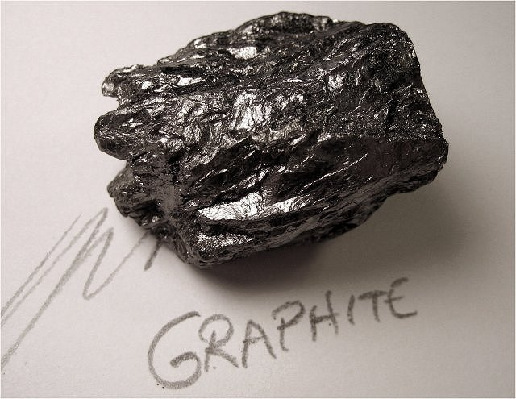
Graphite may be considered the highest grade of coal, just above anthracite and alternatively called meta-anthracite, although it is not normally used as fuel because it is difficult to ignite.

Slide 12
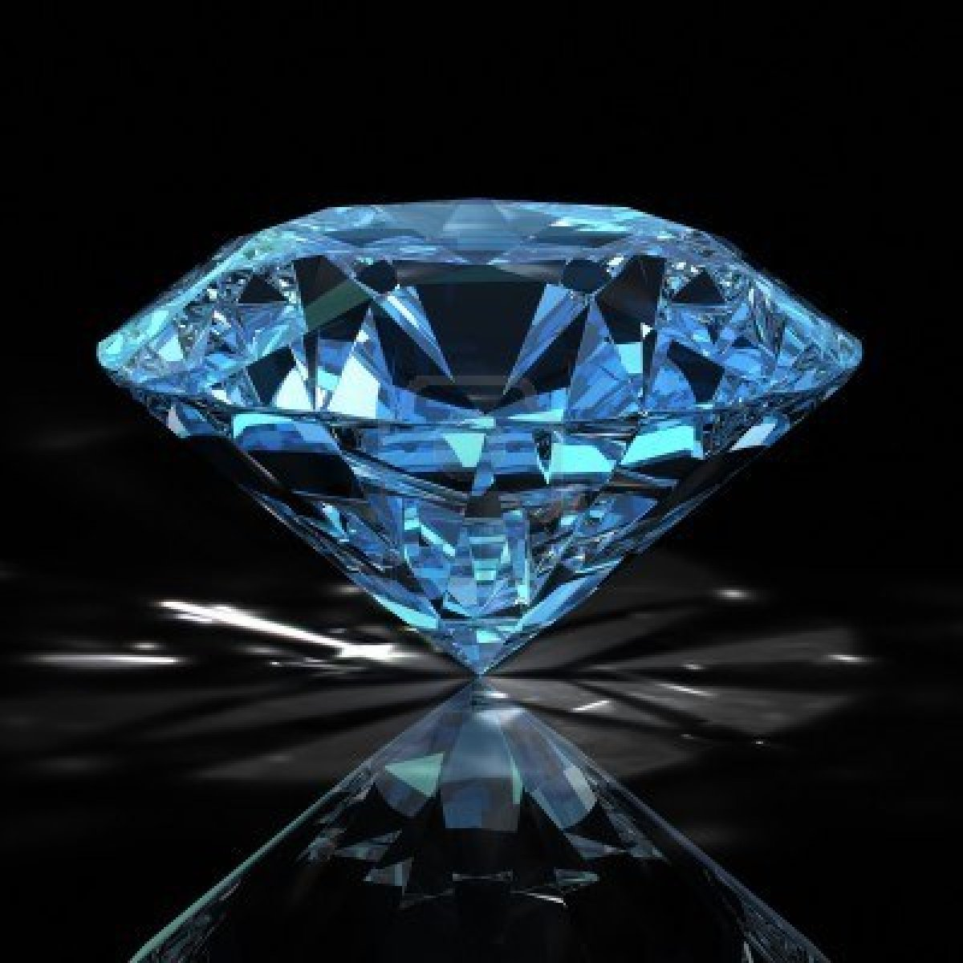
Diamond
Diamond is a allotrope of carbon, where the carbon atoms are arranged in a diamond lattice.

Slide 13
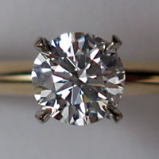
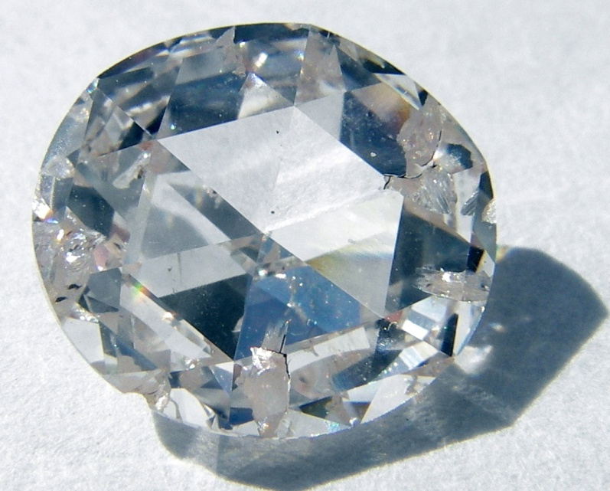
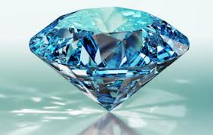
Diamond is a material with superlative physical qualities, most of which originate from the strong covalent bonding between its atoms. In particular, diamond has the highest hardness of any bulk material.

Slide 14
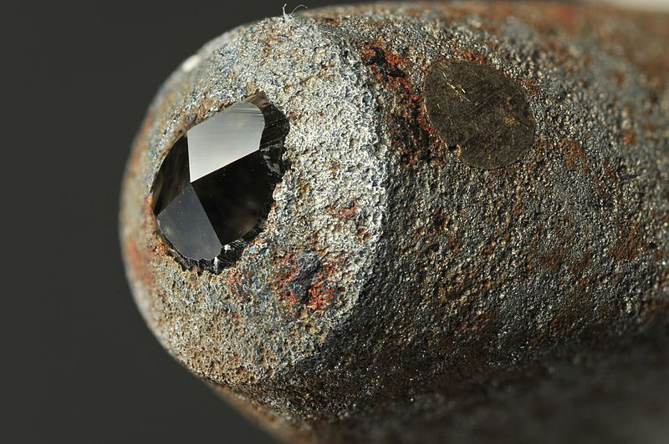
Those properties determine the major industrial application of diamond in cutting and polishing tools and the scientific applications in diamond knives and diamond anvil cells.

Slide 15
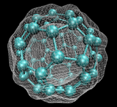
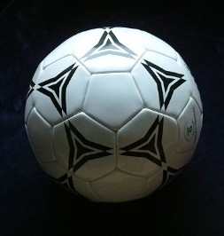
Fullerene
A fullerene is any molecule composed entirely of carbon, in the form of a hollow sphere, ellipsoid or tube. Spherical fullerenes are also called buckyballs, and they resemble the balls used in football (soccer).

Slide 16
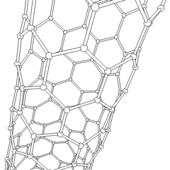
Cylindrical ones are called carbon nanotubes or buckytubes. Fullerenes are similar in structure to graphite, which is composed of stacked graphene sheets of linked hexagonal rings; but they may also contain pentagonal (or sometimes heptagonal) rings.

Slide 17
Question 1
Which two of the following have a great similarity in common in atomic structure; salt, diamond, coal, gold, and silver?
Diamond and coal.

Slide 18
Question 2
How can such different looking materials have this much similarity?
Because they are allotropes of the same element: carbon. Allotropes are different structural modifications of an element. They have different physical properties, but the same chemical properties.

Slide 19
Question 3
Do you know about other famous allotropes in the nature?
Oxygen gas – Ozone
White phosphorus - Red phosphorus
C (diamond) - C (graphite) and Fullerenes

Slide 20
Question 4
You probably know about bowling ball, disco ball, and tennis ball. Likewise, have you heard about buckyball? What is a buckyball?
Buckyball is a spherical fullerene molecule with the formula C₆₀. It has a cage-like ring structure which resembles a classical soccer ball, with 20 hexagons and 12 pentagons, with a carbon atom at each vertex of each polygon and a bond along each polygon edge.

Slide 21
Question 5
Other than buckyball (C₆₀ ), what kind of Fullerene molecules can you name?
Carbon nanotubes, carbon megatubes.
C₇₀, C₅₄₀ and etc

Slide 22
Watch the animation on the website; The Scale of the Universe 2 http://htwins.net/scale2/

Slide 23
Question 6
To what scale is C₆₀ molecules (buckyballs) equivalent? (Answer according to the previous animation named “The Scale of the Universe 2”) Emphasize the size of nanometres.
Alpha Helix, Cs atom, X-ray wavelength and buckyball are nearly at the same size.

Slide 24
Now we divide the class into 4 groups.
Each group has to do a different activity:
Group 1 – activity 1(graphite);
Group 2 – activity 2(diamond);
Group 3 – activity 3(buckyball);
Group 4 – activity 4(nanotubes).

Slide 25
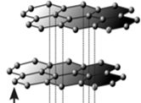
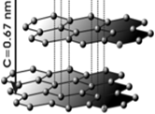
Activity 1: (a) Graphene, (b) Graphite

Slide 26
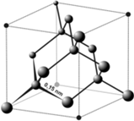
Activity 2: Dimond(2) and crystal structure of dimond(3).

Slide 27
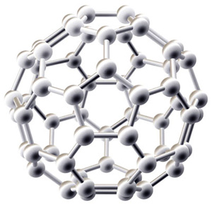
Activity 3: C₆₀ on the coordinate system.

Slide 28
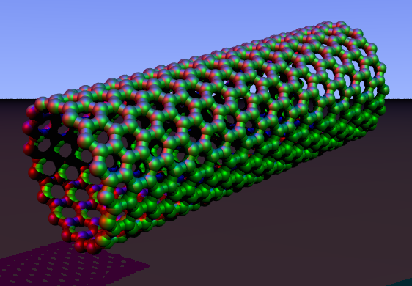
Activity 4:Carbon nanotubes

Slide 29
Question 7
Crumple up another carton paper to be the same size as Buckyball you have built. Press both of them and compare the differences (figure 2). What can you say for this comparison? Which of them is stronger? Why?

Slide 30
Figure 2: Buckyball and Crumple up another carton paper.

Slide 31
Bucykball is more durable than crumpled paper.
Spherical structures distribute the forces applied in equal pieces on their surfaces.

Slide 32
Question 8
What kind of bonding is there in between the carbon atoms of fullerene?
Covalent bonding.

Slide 33
Question 9
Carbon nanotubes are the strongest and lightweight material yet discovered. What can be the application areas of carbon nanotubes?
Buildings
Batteries
solar panels
space vehicles

Slide 34
Question 10
We know that fullerenes show superconducting properties. Which research areas are related to super-conductivity?
Magnetic-levitation
Super conducting magnets especially for transport such as trains
Biomagnetism
Electric generators made with superconducting wire
Energy storage to enhance power stability
"Petaflop" computers

Slide 35
Question 11
Why do you think Fullerenes dissolve in toluene, but not in water?
Water is a polar solvent, but fullerenes are nonpolar substances. That’s why they can only be dissolved in nonpolar solvents.

Slide 36
Quiz
A. Write (T) True or (F) False for the statements below. (5minutes)
( ) 1- Graphite is a conductor and can be used as the material in the electrodes of an
electric arc lamp.
( ) 2- Allotropes have different physical properties and the same chemical properties.
( ) 3- The atoms forming allotropes have the same kind of bonding in between, but in
different manners.
( ) 4- Diamond is a hollow cluster of 60 carbon atoms shaped like a soccer ball.

Slide 37
B. Fill in the blanks with an appropriate expression.(5 minutes)
1- Buckyball is a ……………………molecule with the formula C₆₀.
2- …………………. are different structural modifications of an element.
3- …………………….. is the hardest natural mineral.

Slide 38
I hope that by the end of this presentation you understand better nanotechnology, the allotropes of carbon and their application!
Thank you for the attention!!!
Rositsa Sotirova

